Slide 1
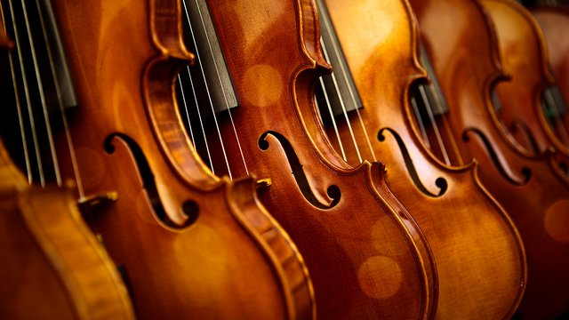
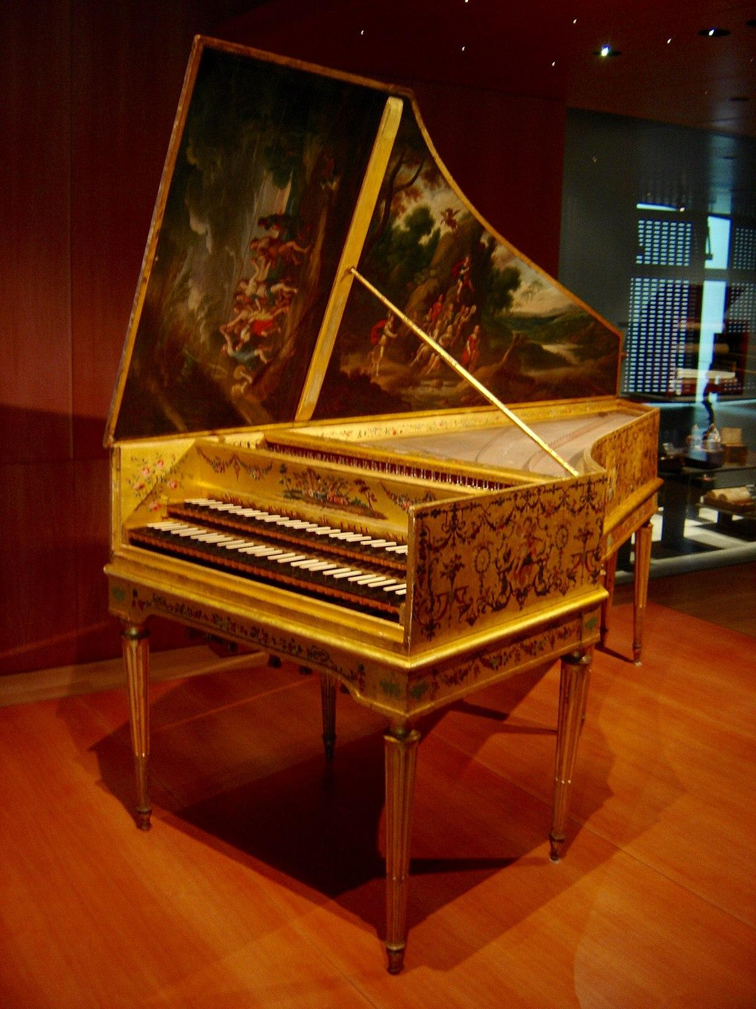
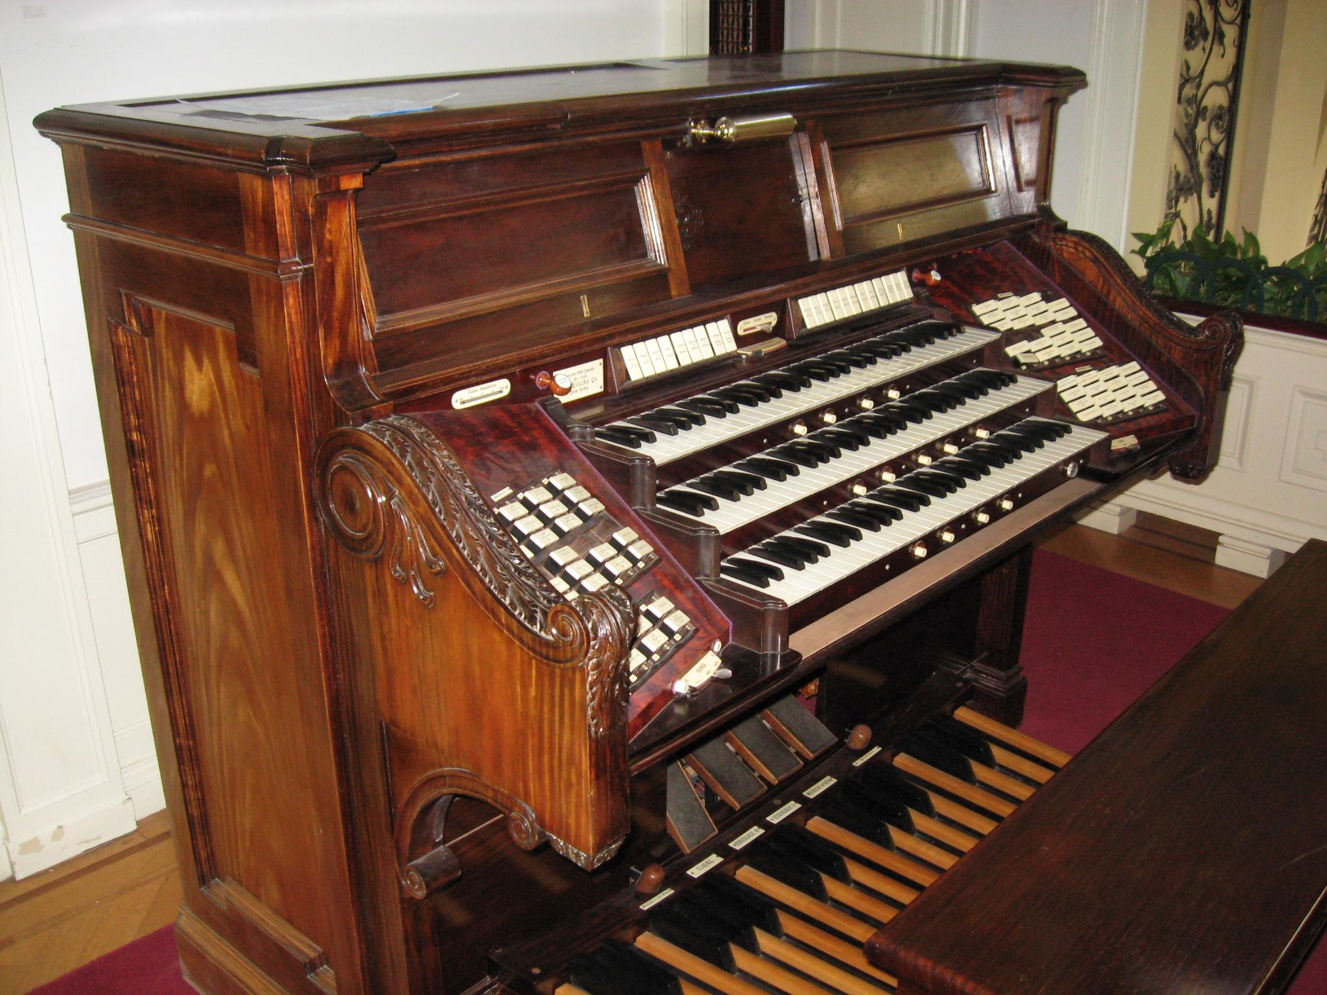
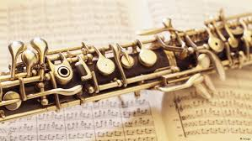
Georg Friedrich Handel
By, Alyss Robertson
-----------------------------------------------------------------------------------------------------------------------------------------------------
-------------------------------------------------------------------------------------------------------------------------------------------------
------------------------------------------------------------------------------------------------------------------------------------------------------

Slide 2
(1685-1759)
In 1899-1700, Handel completes what some scholars consider to be his earliest datable work; Trio sonata in G minor, Op. 2 No. 2
Died at the age of 74 in London, England, in 1759
Born in Halle, Germany, in 1685
Began composing for violin and oboe in 1695
Composed “Messiah”, one of the most famous oratorios in history, in 1741

Slide 3
Georg Friedrich Handel was born in Halle, Germany, on February 23, 1685, and is considered one of the most famous composers of the Baroque Era, along with Bach. Although his father didn’t originally want him to have any interest in music, Handel pursued his passion and soon became a notorious composer. By the age of eleven, he played the harpsichord, violin, oboe, and the organ. Being naturally drawn to operas, he also began to compose his own. One of his most famous oratorios was “Messiah”. An oratorio is “a large musical composition for orchestra, choir, and soloists”, similar to an opera. Handel devised this piece in 1741, when he was seventy-four years old, and it is among the most prominent in history. Another piece Handel composed was the “Music for the Royal Fireworks”. Written in 1749, almost a decade after Messiah, it contrived of five movements and was performed as an outdoor festival preceding a firework display. Throughout his life, Handel had lived in quite a few places. He would travel for reasons other than average; sometimes, it would be for something like an opera. In total, he’s lived in Halle (where he was born), Rome, Florence, Hanover, and London, where he died at the old age of seventy-four in the year 1759.

Slide 4
Fun Facts
Handel actually got into a fight when he was just nineteen, and he never would’ve lived to accomplish anything more if it weren't for a brass button on his jacket
When he was young, Handel’s father didn’t want him to do anything in the musical area, and discouraged him from playing or practising as well as even forbidding him to play. Due to that, one would think Handel couldn’t really practise any instruments, but his father didn’t stop him; he still practised a miniskul clavichord, which is similar to a piano, that he snuck into the house and played when everyone was asleep during the night
Handel was indeed the Kapellmeister (person in charge of music) for George, Elector of Hanover, who soon became King George I; he became the official composer for the king

Slide 5
In addition to his others, Handel also composed a piece called “Water Music”. Written in 1717 on the seventeenth of July, it contains three orchestral movements and is meant for a vast orchestra so can be played outside. It was originally performed on the River Thames by the request of King George I.
https://www.youtube.com/watch?v=Kuw8YjSbKd4

Slide 6
